Slide 1

Thesis Research Development of Healthy and Diseased Stomach Model in-silico to Analyze Slow-wave activities for Gastrointestinal Research
EENG 890-891- Master’s Thesis – I-II 31st August 2018
By
Niyati Prajapati
Master of Science in Electrical and Computer Engineering
Advisor : Dr. Aydin Farajidavar
Assistant Professor, Department of Electrical and Computer Engineering, NYIT, Old Westbury

Slide 2
Pathway
Introduction
Objective : Problem | Solution
Solution : Computational Stomach Model ,Gastric Recording Device
Experimental Results : Analysis of Slow-wave Parameters
Conclusions
Future Scopes
References

Slide 3
Introduction

Slide 4
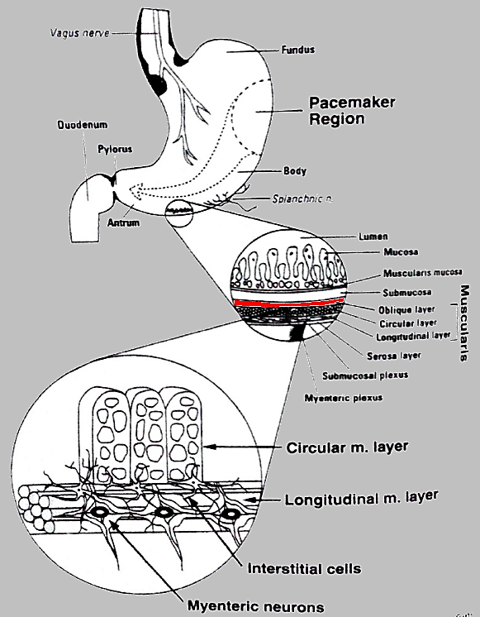
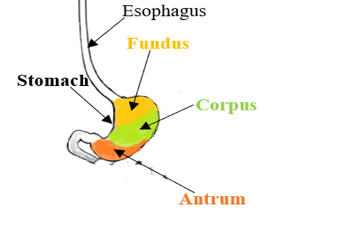

Gastrointestinal motility – a reason for uneven contraction of smooth muscle or slow waves originating in the intestinal cells of Cajal (ICC) of the corpus (upper part of the stomach) which later travels around the circumference of the stomach and then with an increasing velocity, it migrates towards the base of the stomach called antrum.
When a person has this digestive motility disorder, the muscles don’t contract and relax in a coordinated rhythm, so the food doesn’t properly pass through intestine. That causes various digestive symptoms, i.e.; Gastroparesis and Dyspepsia.
Fig.1.Action potential

Slide 5
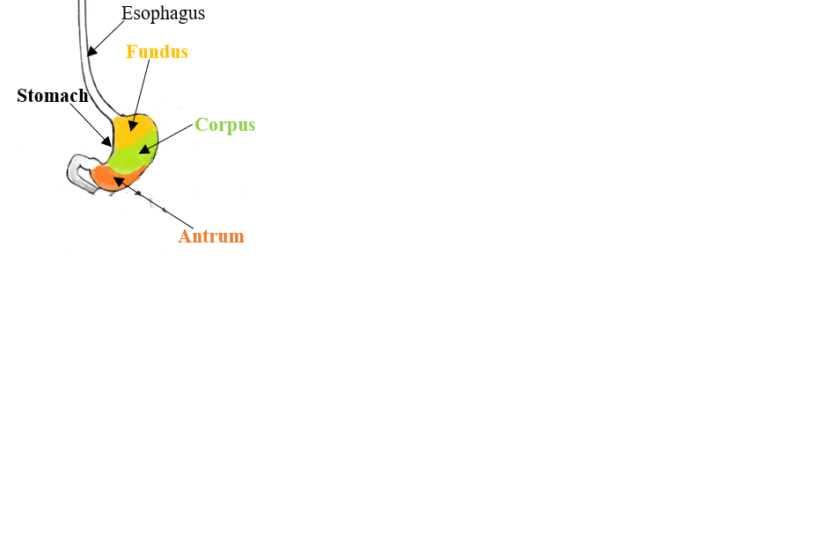
Gastrointestinal Research Background
John F. Nunn identified significant knowledge of Gastrointestinal diseases.
The Enterra™ II model 37800 - Gastric neurostimulator
- Programmable, implanted device that generates mild electrical pulses to
treat chronic intractable nausea and vomiting associated with gastroparesis
Research Areas of GI | Research Scientists | Invention
FSM equivalent ICC model | Peng Du | Active/Passive State-Transition of ICC
Acidity | Jesse McClendon | Tested Acidity of Human Stomach In-Situ (1915)
Electrogastrography | Walter Alvarez | 1921-22

Slide 6
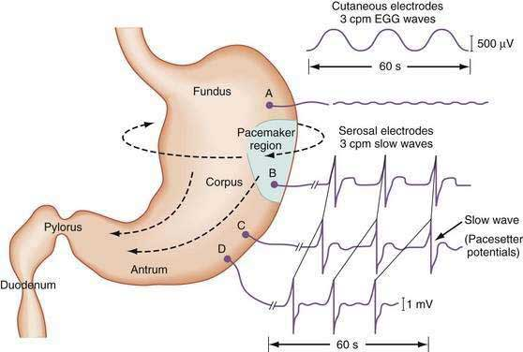
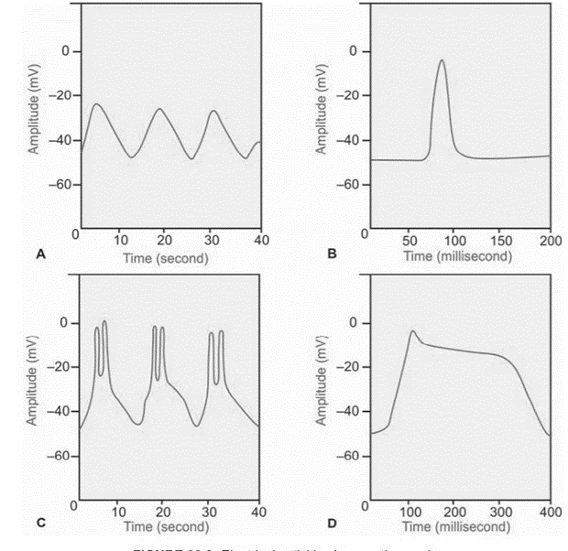
Fig.2.Slow-wave Propagation Fig.3.Electrical Activities and Slow-wave Propagation in Smooth-muscle
Slow-Wave Activity
A=Slow-wave rhythm of resting membrane potential
B=Spike Potential
C=Spike Potential Initiated by slow wave Rhythm
D=Action Potential with Plateau
Sequential activation of ICCs , activates the whole ring and then the rings in antegrade sequence

Slide 7
Objective : Problem | Solution

Slide 8
Objective –Develop a Mathematical Model of Stomach to Recognize Healthy and Diseased State of Stomach by analyzing the Properties of Slow-wave.
Problem
Solution
Diseased Stomach –
Gastric Dysthymias (Disorders). i.e;
1.Bradygastria : < 3cpm Slow-wave frequency (about 2cpm )
2.Tachygastria : > 3cpm Slow-wave Frequency (about 5cpm)
{cpm: Cycles Per Minute}
Treatment – low-frequency, high-energy stimulation to entrain the stomach at a rhythm of 3 cycles per minute (normal condition)
Diagnosis - Gastric Pacing- (to make it Healthy Stomach)
1.Record the Slow-wave Activity
2. Analyze the Sow-wave parameters
3.Recognize the Healthy/Diseased State of Stomach
4.Apply Stimulation of 3cpm

Slide 9
Solution : Computational Stomach Model, Gastric Recording Device

Slide 10
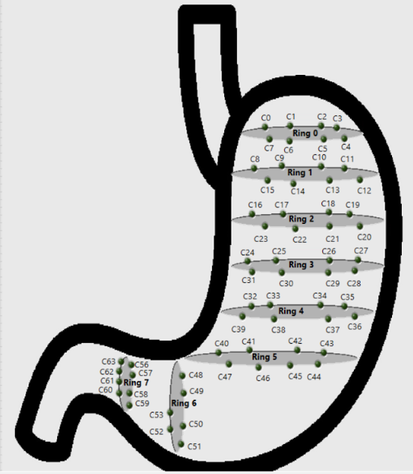
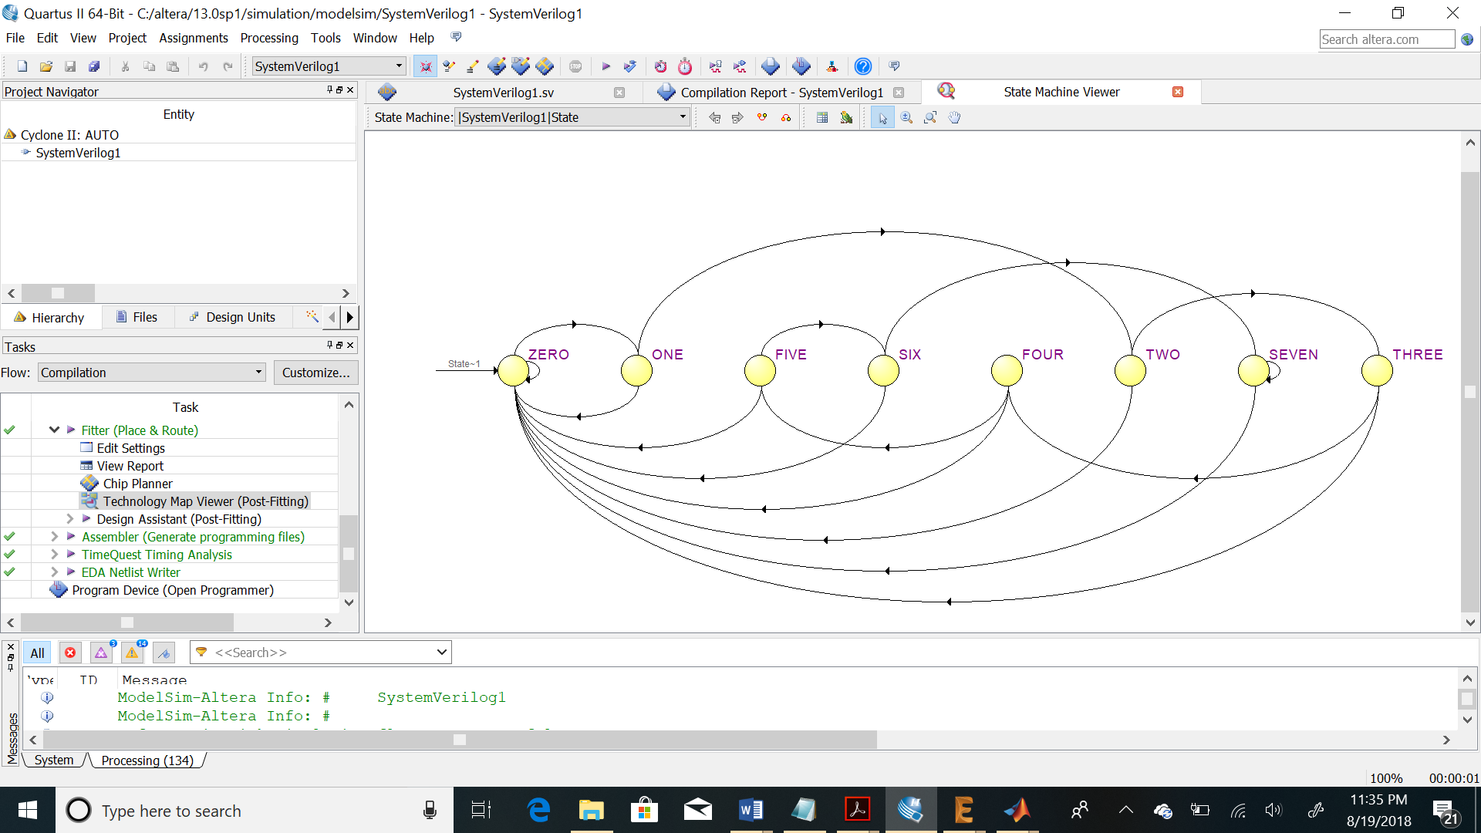
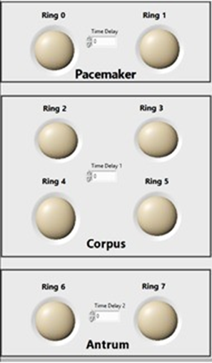
Stomach | Ring | ICC | Delay-time between Each Ring
Pacemaker | Ring0 | ICC1- ICC5 | 2sec
 | Ring1 | ICC6 – ICC9 | 1sec
Corpus | Ring2 | ICC10 – ICC14 | 8sec
 | Ring3 | ICC15 – ICC19 | 8sec
 | Ring4 | ICC20 – ICC 24 | 8sec
 | Ring5 | ICC25 – ICC29 | 8sec
Antrum | Ring6 | ICC30 – ICC33 | 2sec
 | Ring7 | ICC34 – ICC36 | 2sec
Fig.4.Location of 64-Electrodes in Stomach, State Machine Viewer , Ring Distribution with ICC and time delay

Slide 11
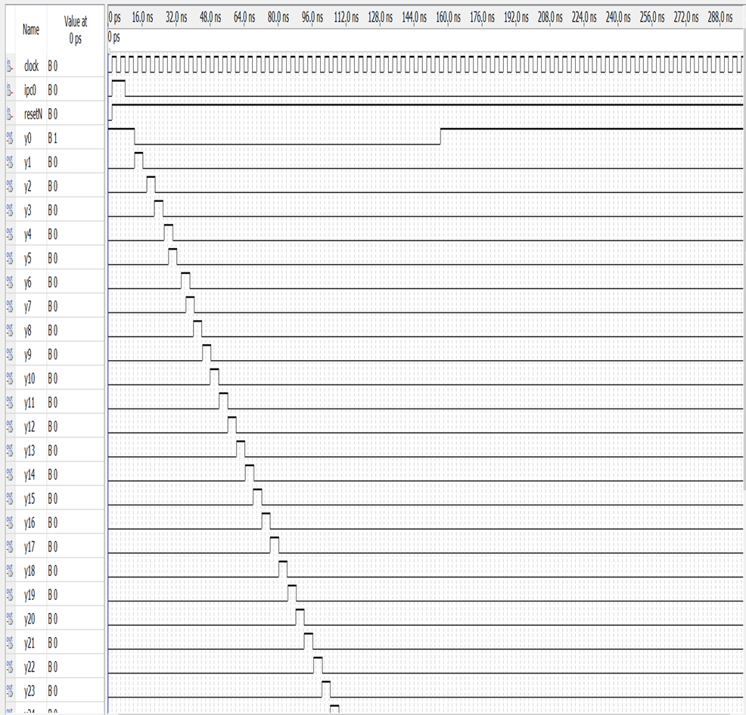
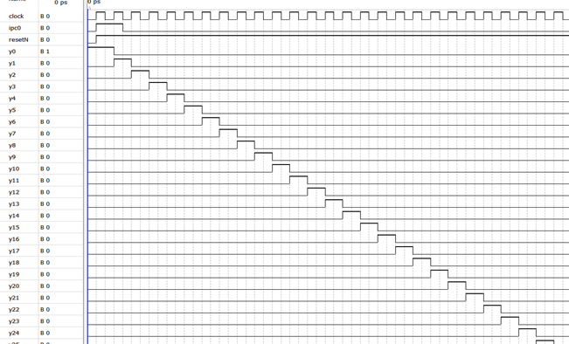
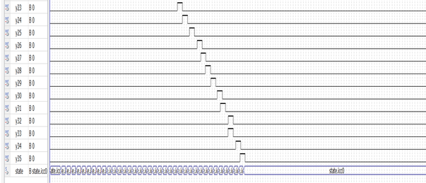


Healthy and Diseased Stomach Model
Fig.5. (A) Slow-wave Pattern in Healthy Stomach , (B) Slow-wave Pattern with Bradygastria Disorder

Slide 12
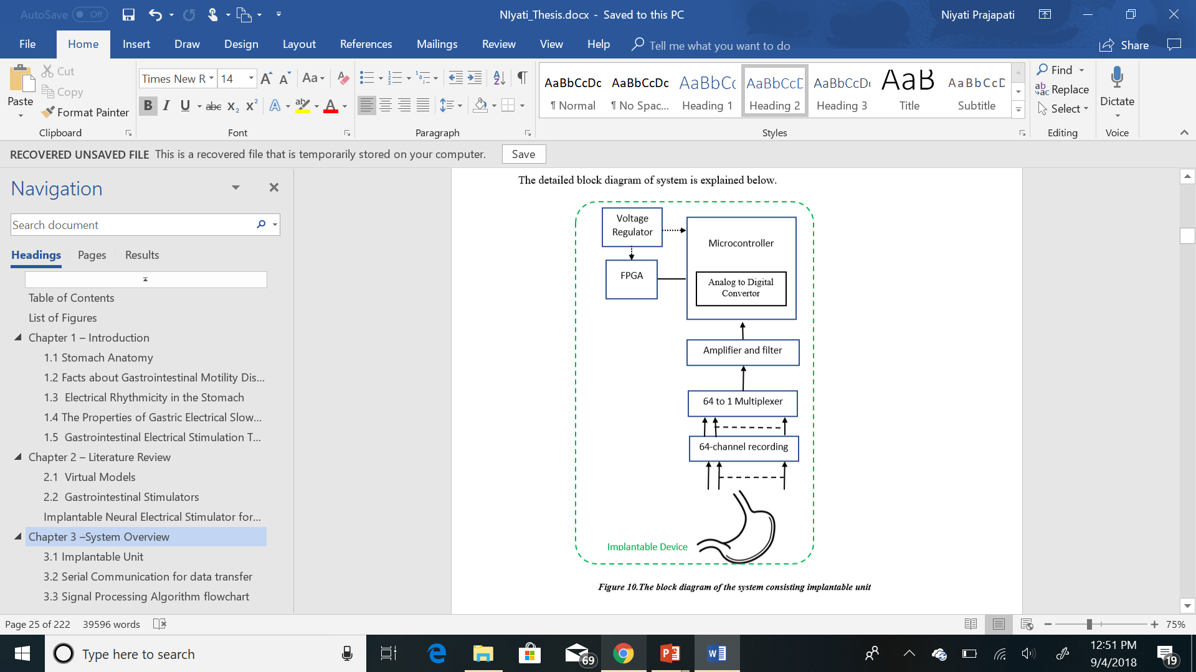
System Overview and Workflow
Fig.6. Block Diagram of system consisting Implantable system

Slide 13
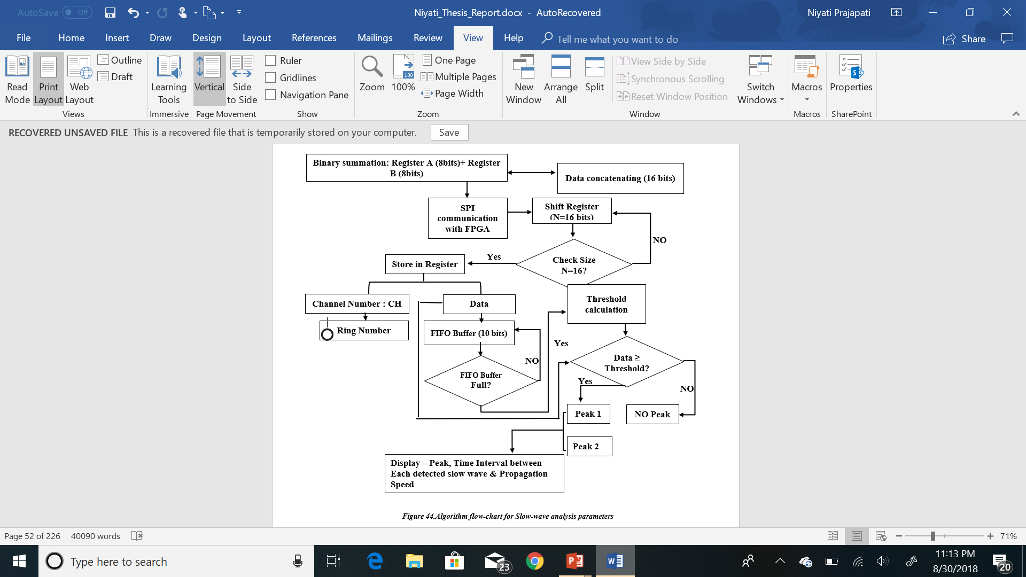
Algorithm Flow for Slow-wave Parameters Analysis
Fig.7. Algorithm Flow for Slow-wave Parameters Analysis

Slide 14
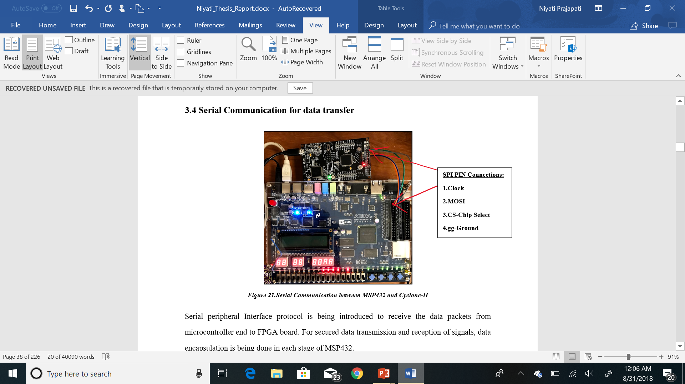
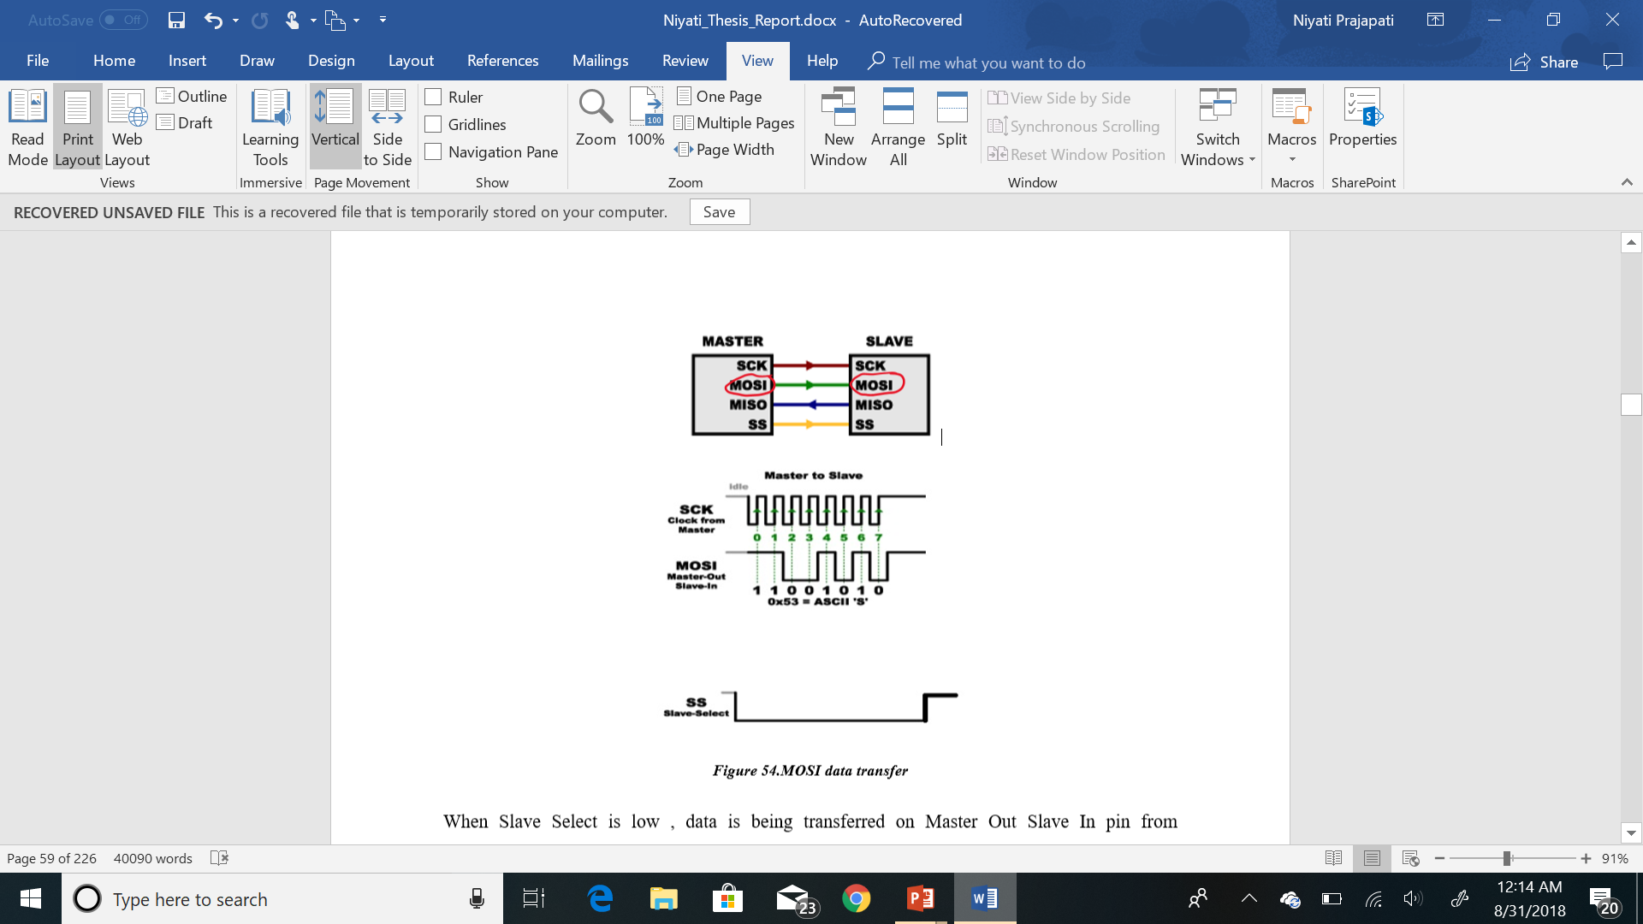
Ring no. | Channel no.
0 | (0-7)
1 | (8-15)
2 | (16-23)
3 | (24-31)
4 | (32-39)
5 | (40-47)
6 | (48-55)
7 | (56-63)
Fig.9.Mater Out –Slave In
Signal Name | FPGA Pin No. | MSP432 Pin No.
GPIO_0[0] | PIN_D25 | Clk-3.5
GPIO_1[1] | PIN_J22 | MOSI-3.6
GPIO_2[2] | PIN_E26 | SS_2.7
GPIO_3[3] | PIN_E25 | GND
Fig.8.Serial Peripheral Interface between Altera-DE2 & MSP432

Slide 15
Experimental Results : Analysis of Slow-wave Parameters 1.Chnnel number (Electrode number) 2.Ring number 3.Slow-wave detection suing Peak detection 4.Time Interval Between each Slow-wave 5.Propagation Speed of Slow-wave

Slide 16
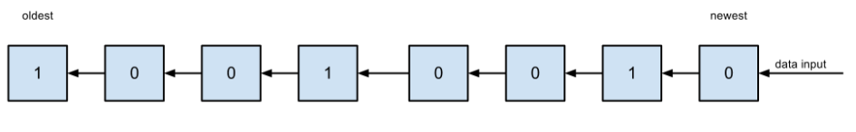
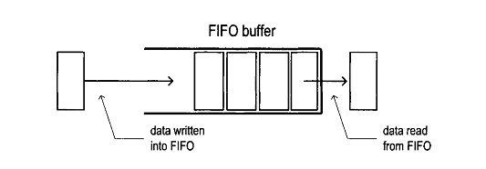
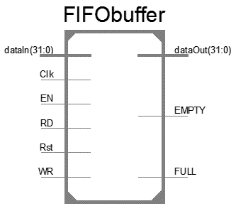
// shift register always @(posedge CLK) begin
//bit shift register bitShiftReg <= {bitShiftReg[15:0],DATA_IN};
//byte shift register byteShiftReg[0] <= bitShiftReg; for(i=1;i<16;i=i+1) byteShiftReg[i] <= byteShiftReg[i-1];
Fig.10. (A) Shift Register – 16 bits (B) FIFO Buffer Implementation (size=1024 bytes)

Slide 17
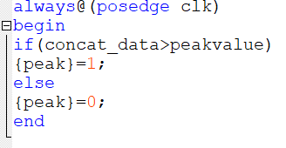
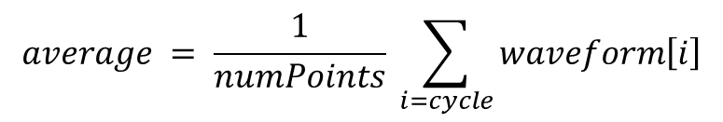
$$average = \frac{1}{numPoints} \sum_{i=cycle}{waveform\left[i\right]}$$
Fig.11. Slow-wave Detection with Peak-detection Method
Time Interval Between each peak = Time_{peak0} - Time_{peak1} = 20 sec (3 cpm – slow wave occurrence in healthy human stomach , ideal condition)
Propagation Speed = (Distance between each electrode= 4mm) / Time Interval(20sec) = 0.2mm/sec which is ideal propagation speed for slow-wave in healthy stomach.

Slide 18
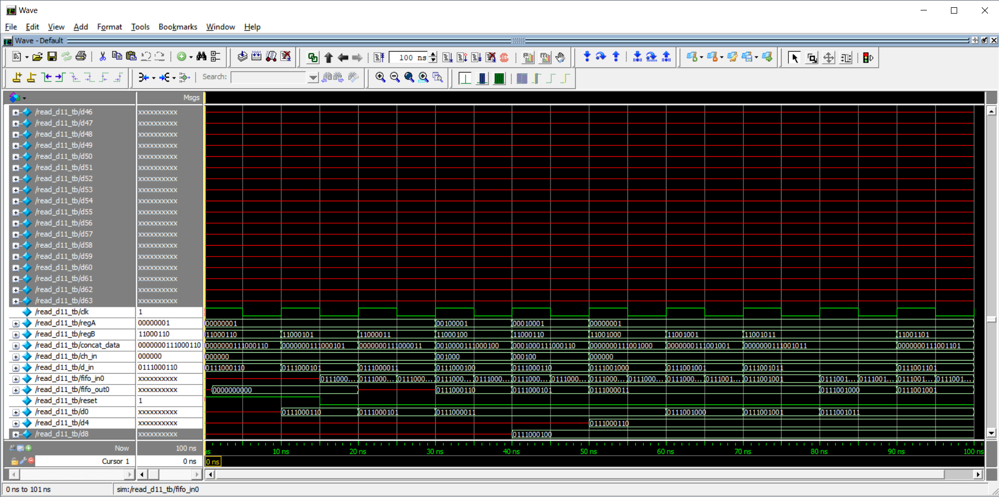
Result-1
1.Channel No. (Slow-wave location)
2.Slow-wave detection
FIFO implementation successfully finds the slow-wave and its location at Ring0 and Ring1.
System Verilog of testbench code recognizes slow -wave location at electrode number with: ch_in = 000000 (channel 0)
Fig.12. Wave form representation for Finite state machine of Human stomach model
Channel no.0 | 000000
Data : 454 | 0111000110

Slide 19
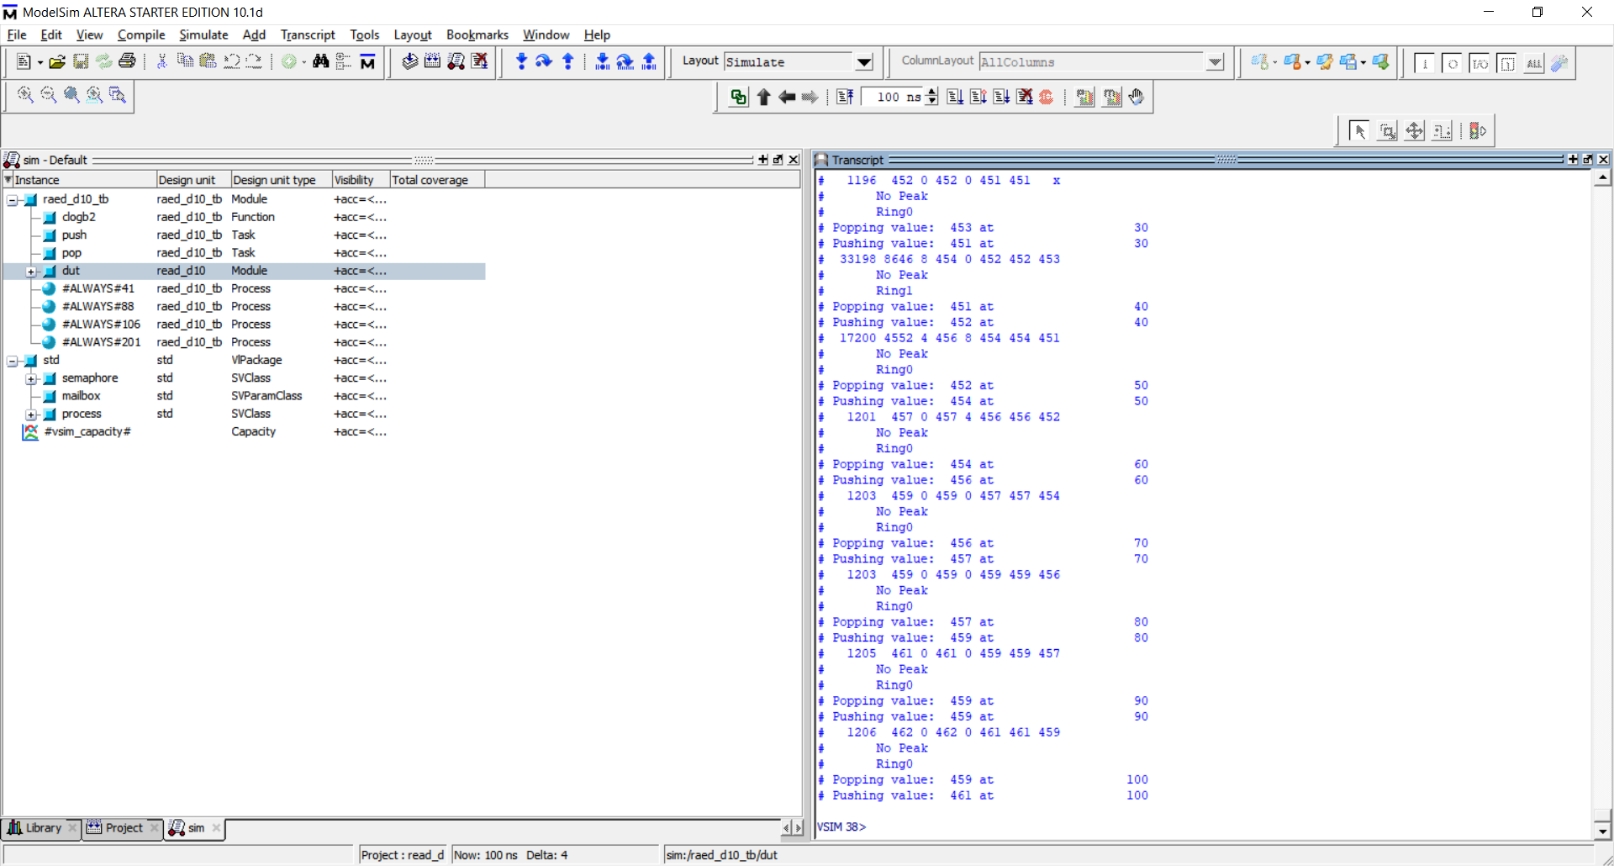
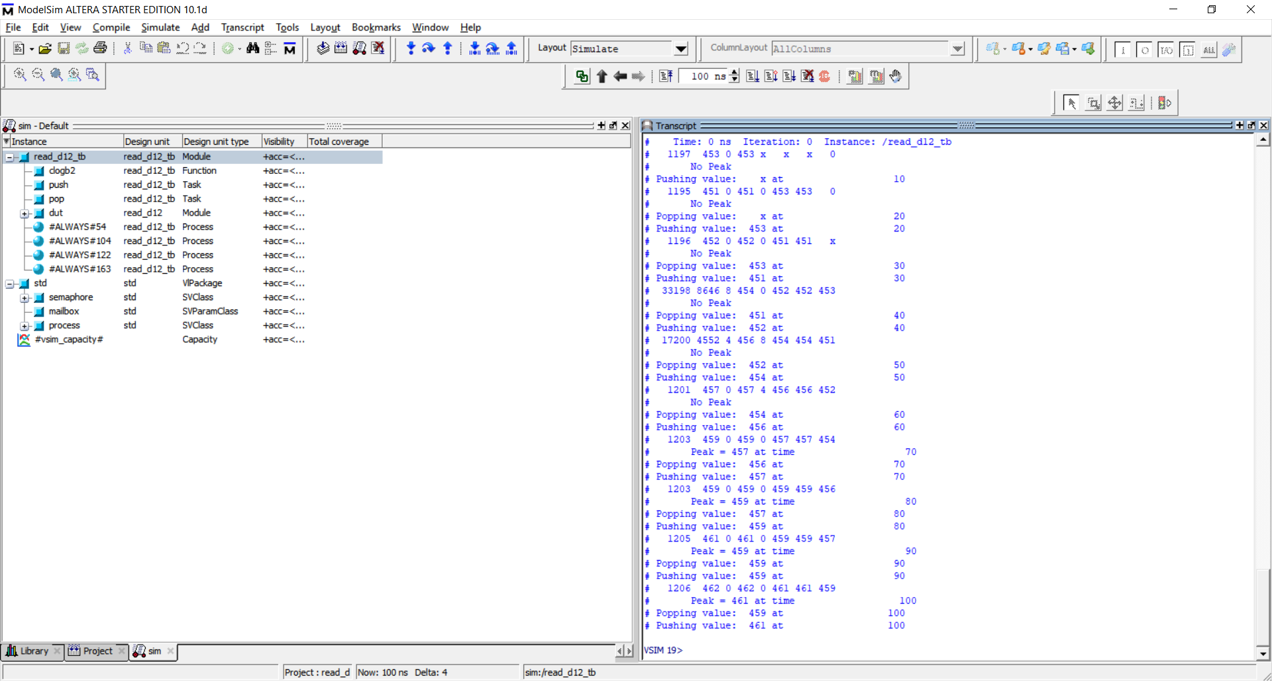



Result-2
3.Ring No.
Result 3.
4.Peak value Display & No peak Display
Channel no : 0-7 | Ring0
Channel no : 8-15 | Ring1
Fig.13. (A) Ring Recognition & (B) Peak Detection Display

Slide 20
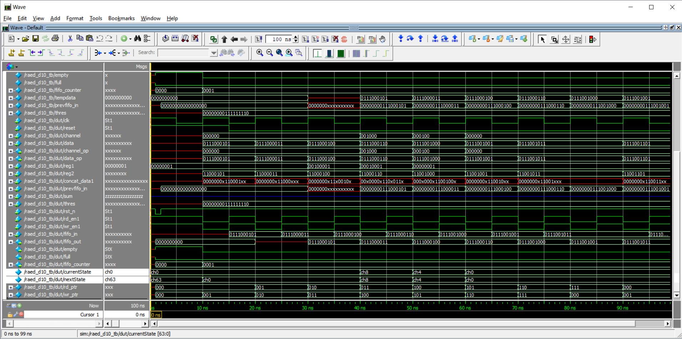
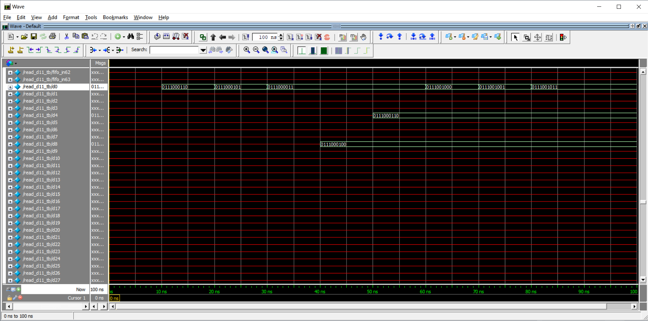
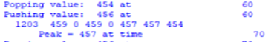
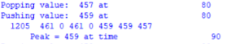
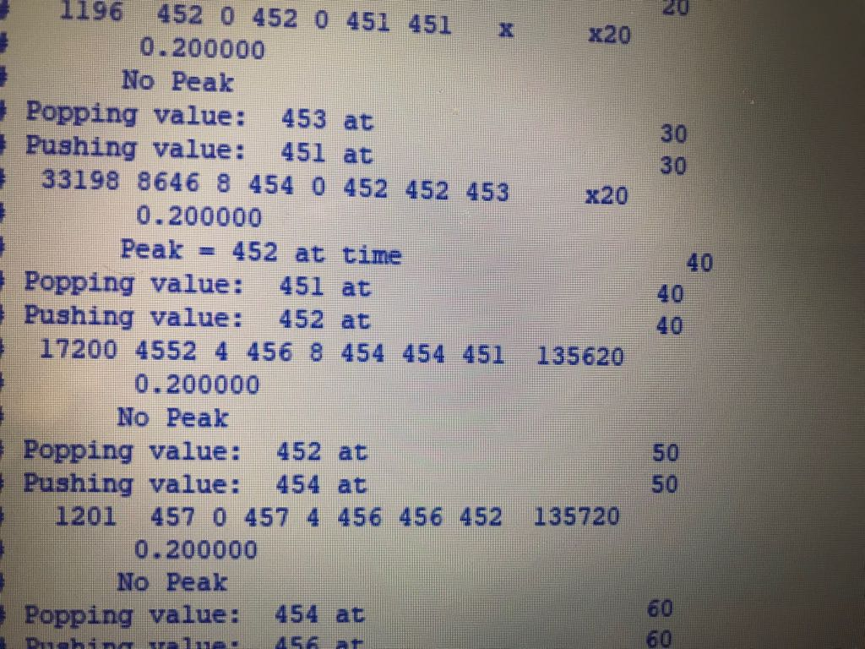

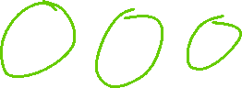



Result 4. (a) 5. Channel no. (b) 6. Channel Data value
.
Result 5.
7. ModelSim result for Time interval between two detected Slow waves
Peak 1 = 457 | T1=70sec
Peak 2 = 459 | T2=90sec
8.Propagation Speed and Time-Interval of Slow-wave
Result 6.
Propagation speed =0.200 mm/sec | Time Interval = 20 sec
Fig.14. (A) Channel Detection (B) Channel data (C) Time Interval (D) Propagation Speed

Slide 21
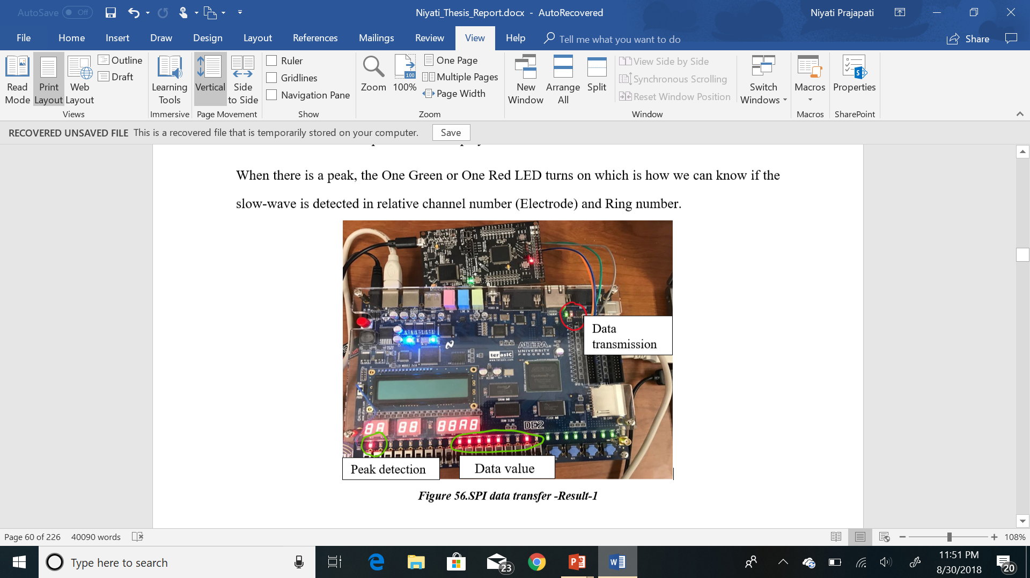
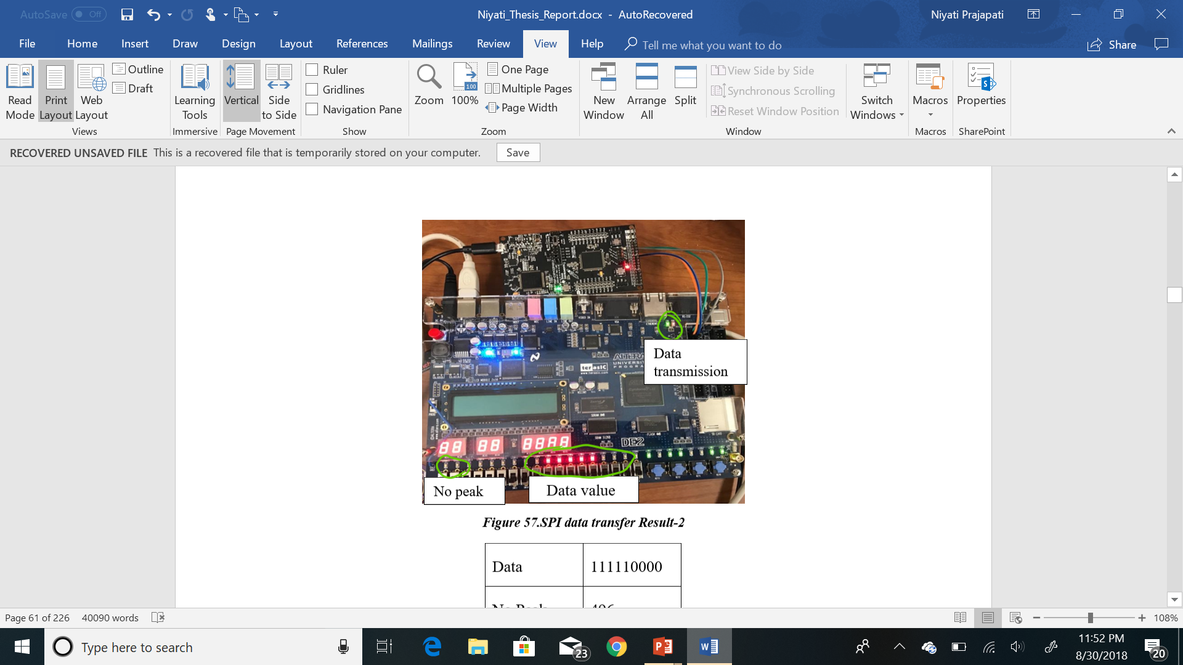
Data | 111110010
Peak | 498
Result 7. (a)
8.SPI data transfer with Slow-eave detection
Data | 111110000
No Peak | 496
Result 7. (b)
9.SPI data transfer with NO Slow-wave detection
Fig.15. Serial Peripheral data Transmission (A) Peak/SW Detection (B) NO peak/SW Detection

Slide 22
Conclusions
This experimental study of gastrointestinal research presents a new computational method (FSM) for analyzing gastric slow-wave entrainment and its parameters. The implantable unit , having 64-electrodes , is able to record from 64 different channels with different frequencies and amplitudes as well as it automatically detects and analyzes the recorded slow-wave signals with System-Verilog code and testbenches designed in Quartus-II software with ModelSim simulation software.
After performing various experimental analysis with the 64-channel implantable and recording system, it was noticed that each time modified data input of slow-waves gives an interesting results for three parameters like, Slow-wave detection ( with peak detection method by averaging filter by counting varying threshold) , the exact time interval between the each peak that is 20 sec in a normal condition (healthy stomach) by considering detection of 3 slow-waves per minute and the propagation speed (in mm/sec) of slow-waves (by considering distance of the electrodes 4mm).

Slide 23
Conclusions
By introducing the FPGA in the implantable system , we can make the data processing faster on microcontroller end because signal -processing is being done by FPGA board.
Instead of waiting for FIFO buffer to count the threshold value , the new method can be implemented to store the detected data values in back ground memory look up table to count threshold value and let the algorithm display the continuous monitoring of three parameters called : slow-wave location with electrode number and Ring number as well as time interval between each slow-wave that occurs during the event and its propagation speed.
The limitation for the computational (mathematical) stomach model (designed with 64 ICCs and 8 rings) is that the ModelSim software needs professional version of license to perform data analysis for longer time. As for 64-channel ICC stomach model, it takes a limited size of buffer to process threshold counting for slow-wave detection. The Serial peripheral Communication is possible for the only frequency at which MSP432 and FPGA board Altera-DE2 synchronizes.

Slide 24
Future Scope
The User interface (UI) application (made in Quartus - II software) still need to be modified to stimulate the slow-wave (but not only record and analyze) to detects the Gastric dysrhythmias like Bradygastria and Tachygastria as well as for the better treatment of Gastric disorders by studying its data analysis.
The successful implementation of system with laboratory tests and results gives an opportunity to test the same experiments for animals and humans stomach in the future.
UI - could be modified to display the analyzed gastric parameters, e.g.; slow-wave detection, its location (Channel number, Ring number), propagation speed on LCD interface.
It would be a great challenge to perform a continuous data analysis (for longer time of more than an hour via Serial peripheral Communication ) and see how fast the FIFO buffer calculates the accurate threshold value while the FIFO buffer is getting empty once it is full.
Different individual has different anatomy of stomach and so knowing it beforehand, it becomes easier to predict and analyze gastric parameters and the pattern of slow-wave propagation from Pacemaker to Antrum.

Slide 25
Future Scope
Flexible Printed Electronics circuits - light weight for gastric application because device made from stretchable electronic materials could be easily attached to the body.
Single -walled carbon nanotube is one of the best mediums of ink to print flexible
electrodes with 3D printer, it is because the mechanism allows the flexible PCB of electrodes
to act as a strain sensor which is capable of having 50 times more sensitivity than the normal
electrodes. Apart from that, they have high durability, fast response and low creep.

Slide 26

Thank You!

